Slide 1
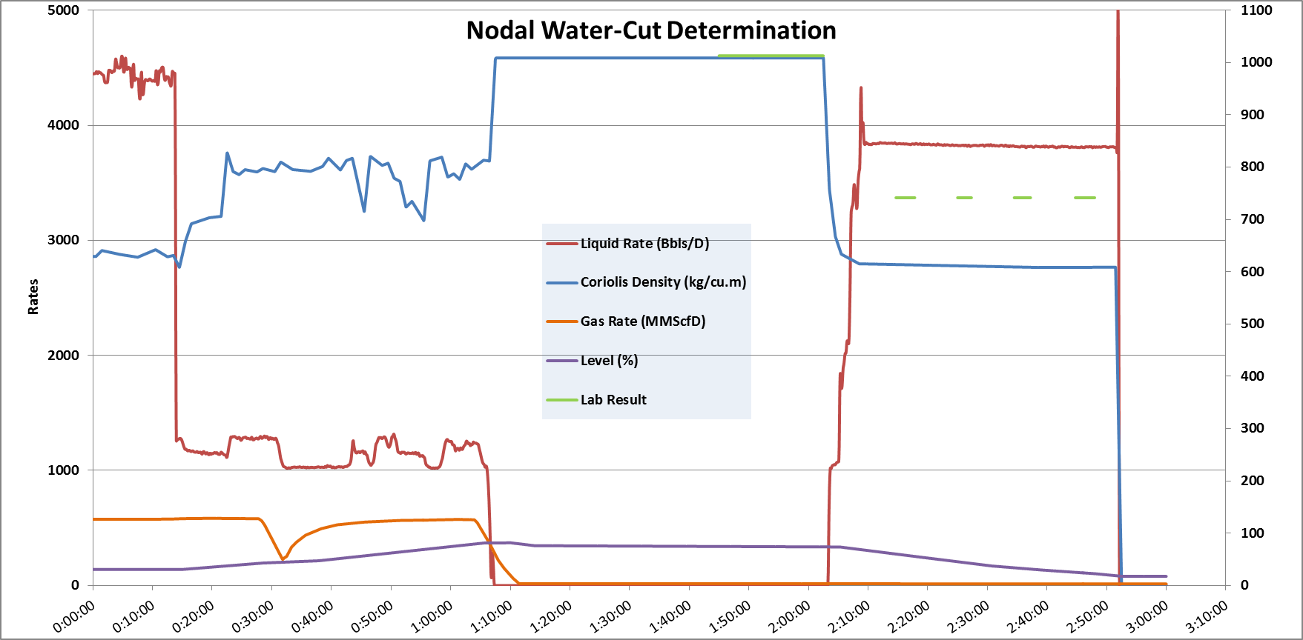
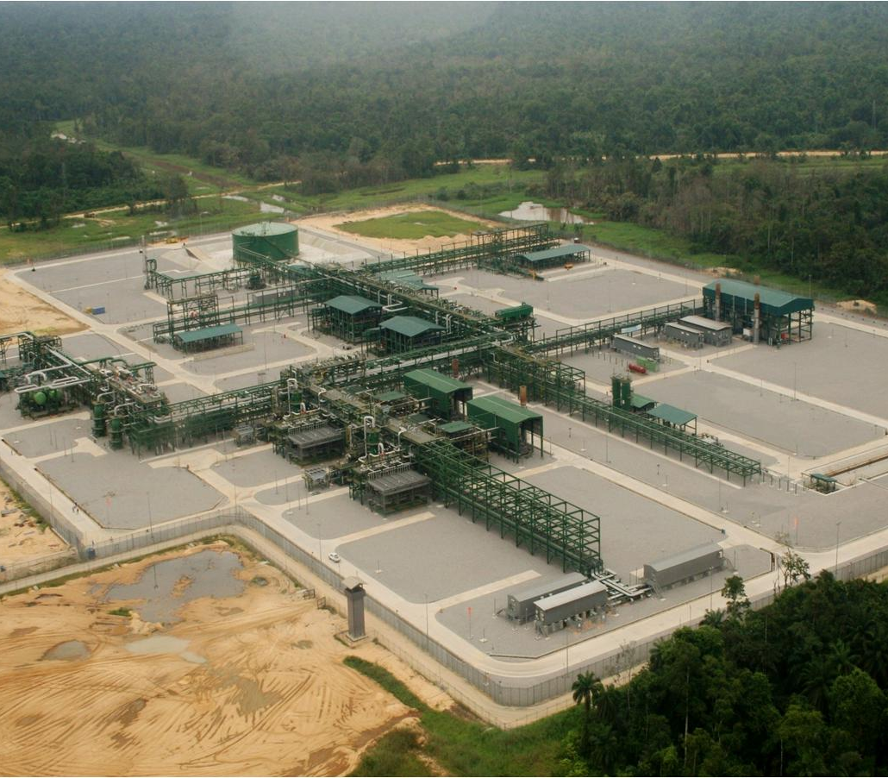
Nodal Water-Cut Determination using Decantation Technique. Using the Decantation Technique
Chimdike IHE & Ekine Ogbokuma
Production Operations, Gbaran-Ubie

Slide 2
Agenda
Gas well Testing
Sampling challenges
Decantation approach
Results/Discussions
Way Forward

Slide 3
Gas well Testing
Two conventional approaches exist for NAG WELL test;
Through a dedicated test separator.
Schlumberger well test module.
Provision is not made for NAG well testing in the Gbaran CPF,
Well testing is done through testing by difference
Testing by elimination.
Testing by difference
In this technique, all the wells flowing into the nominated slug catcher opened to their maximum advised potentials.

Slide 4
Sampling Challenges
A major challenge associated with methods is determination of the right CGR from the slug catcher as a result of the following reasons;
Tapping point of Walker sampling unit is at the 9 o’clock position of the pipeline.
No form of agitation before Coriolis meter or sample point
Liquid Flow

Slide 5
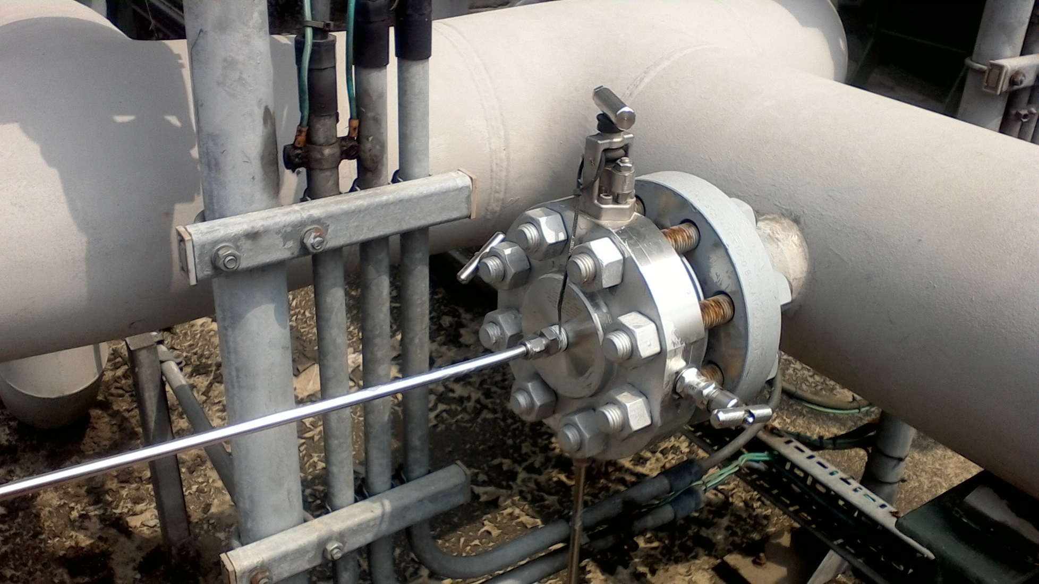
Condensate outlet
Sampling point tapping

Slide 6
PIPE ‘’HOLD UP’’ ANALYSIS
12 o’clock
Pipe cross-sectional area not occupied by the fluid
Pipe cross-sectional area occupied by the condensate
3 o’clock
Sample instrument tapping point
Pipe cross-sectional area occupied by water.
6 o’clock

Slide 7
PIPE ‘’HOLD UP’’ ANALYSIS Cont’d
The fluid occupies only a cross-sectional area of the pipe called the ‘’Hold up’’ and not the entire diameter of pipe.
Sampling point at the middle of the pipe.
Flow through the pipe is laminar
By gravity the condensate ‘floats’ on the water.
Sampling challenges.
There is a measure of separation by gravity and because of this the sampling point tapping, most times the sample is consist mainly of water.
It therefore becomes almost impossible to get a representative sample.
Also there is no form of agitation before the sampling point to help mix the two fluids.

Slide 8

Water-Cut Algorithm
$$WC=\frac{ρ_{m}−ρ_{C}}{ρ_{W}−ρ_{C}} 0≤wc≤1$$
$$ρ_{m}=Mixture Density$$
$$ρ_{C}=Condensate Density$$
$$ρ_{W}=Water Density$$

Slide 9
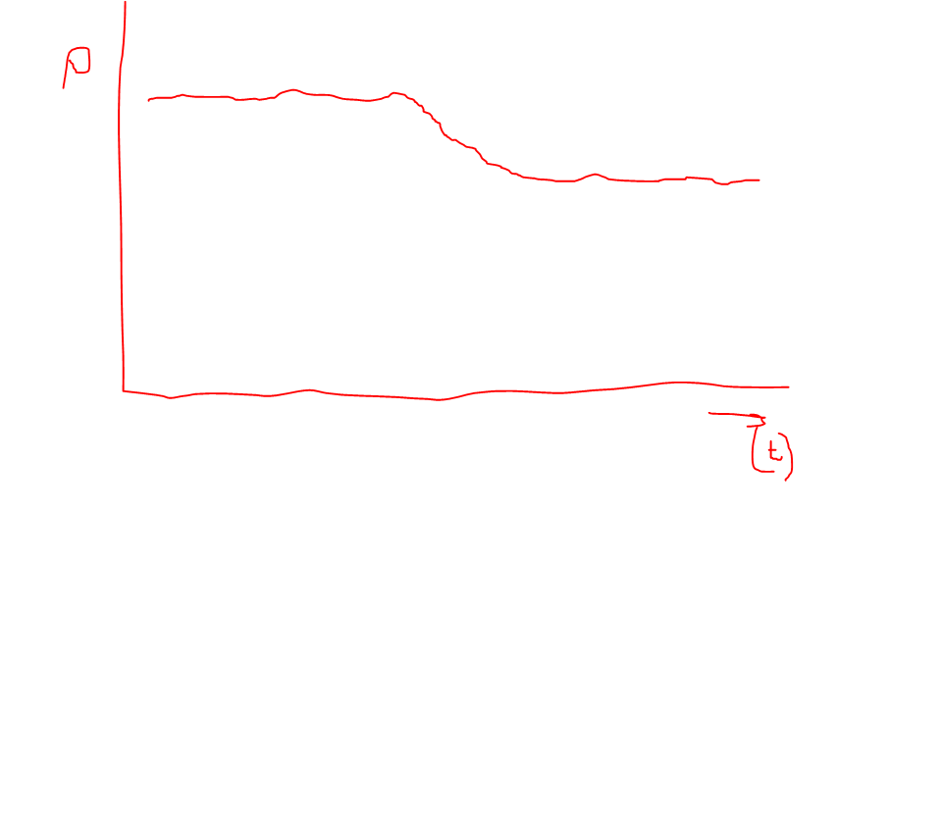
Decantation approach
Gas Out
Gas in
Condensate
Water
Liquid out
Sampling point

Slide 10
Decantation approach (Contd.)
Establish density trends real time monitoring on PAS.
Simultaneously monitor density from Coriolis to corroborate with sample analysis
Concerns/Support
PACO to support ; provide a faceplate for density trends from the Coriolis meter.
PC lab to support with time-stamped sample analysis of condensate.
Obtain IAP deferment approvals for nominated node to be tested.
Obtain override for the level shutdown instruments.
PACO to check the level instruments on the nominated slug catcher in preparation for this exercise.

Slide 11
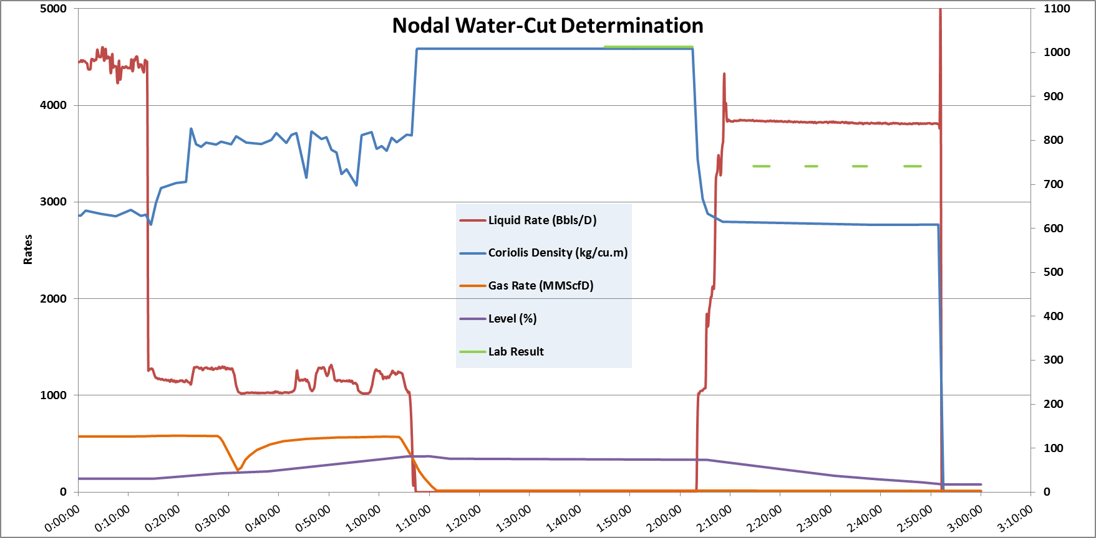
Results and Findings

Slide 12
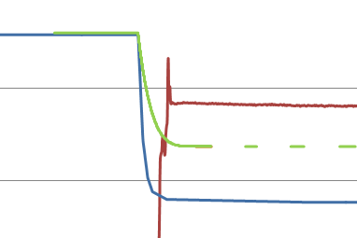
Results and Findings
Variance between laboratory and Coriolis density values.
@1700hrs, density = 1013kg/m³ (lab); 1008kg/m³ (Coriolis) 5kg/m³
@1715hrs, density = 742kg/m³ (lab); 613kg/m³ (Coriolis) 129kg/m³
Reference to same PVT conditions???

Slide 13
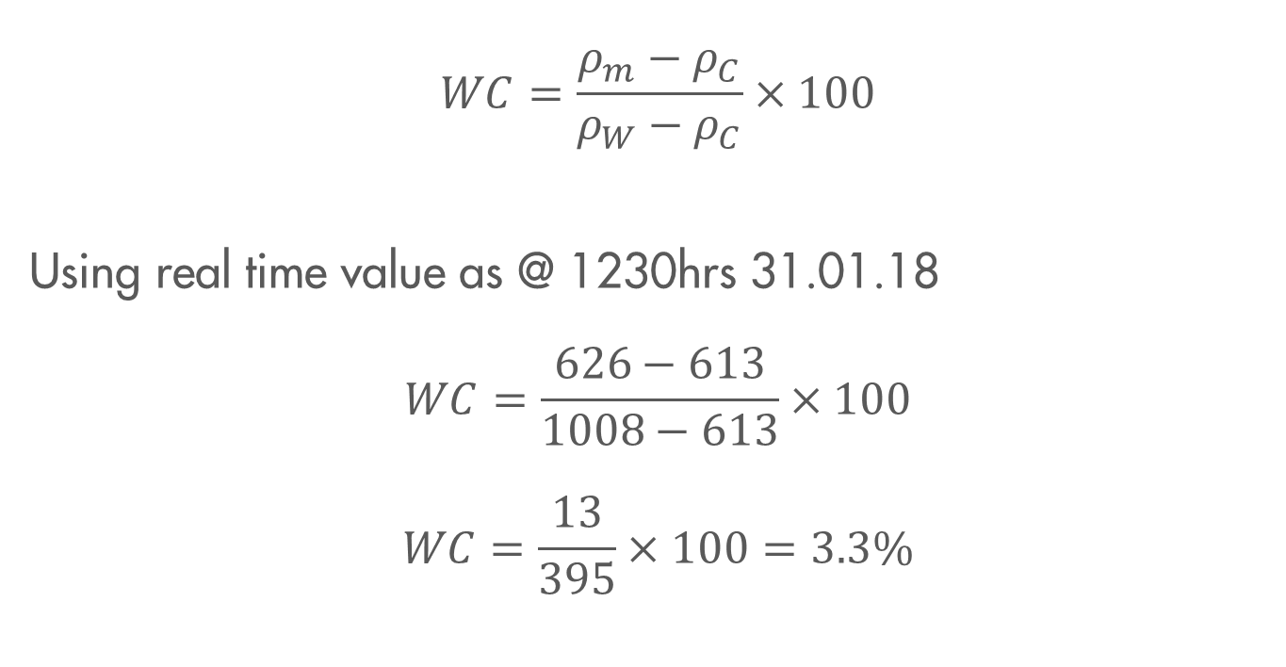
WC Computation (Coriolis Only Values)
$$WC=\frac{ρ_{m}−ρ_{C}}{ρ_{W}−ρ_{C}}×100$$
Using real time value as @ 1230hrs 31.01.18
$$WC=\frac{626−613}{1008−613}×100$$
$$WC=\frac{13}{395}×100=3.3\%$$

Slide 14
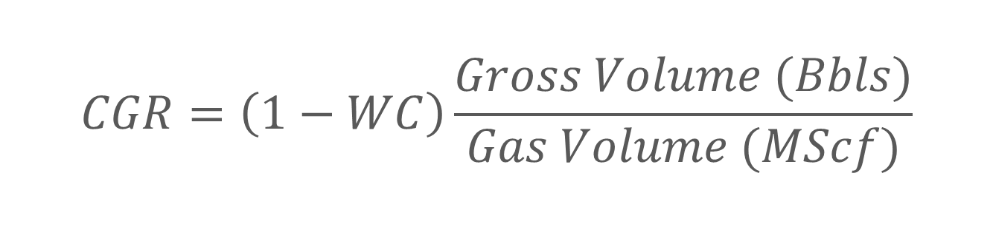
CGR Computation (Coriolis Only Values)
$$CGR=\left(1−WC\right)\frac{Gross Volume (Bbls)}{Gas Volume (MScf)}$$

Slide 15
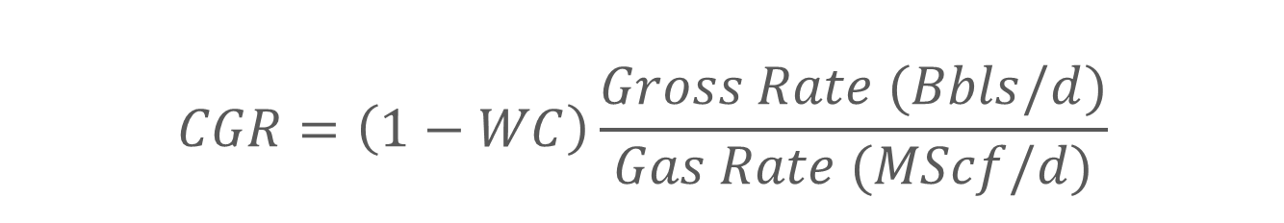
CGR Computation (Coriolis Only Values)
$$CGR=\left(1−WC\right)\frac{Gross Rate (Bbls/d)}{Gas Rate (MScf/d)}$$

Slide 16
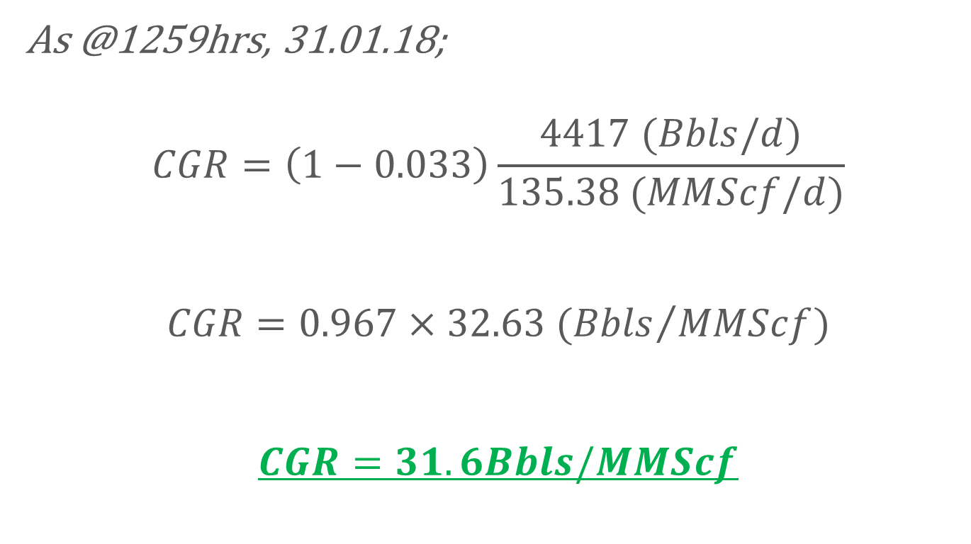
CGR Computation (Coriolis Only Values)
As @1259hrs, 31.01.18;
$$CGR=\left(1−0.033\right)\frac{4417 (Bbls/d)}{135.38 (MMScf/d)}$$
$$CGR=0.967×32.63 ({Bbls}/{MMScf})$$
$$CGR=31.6Bbls/MMScf$$

Slide 17
Precautions Taken
Steady blanketing pressure (97.8Bar).
Maintained steady flow above design minimum (Min. 2040BBlpd; TDR=20:1).

Slide 18
Note of Caution!
CGR @ SlugCatcher Vs. Wellhead???

Slide 19
Concerns!
Using the CGR @ SlugCatcher Vs. Wellhead???

Slide 20
Way Forward
Correct lab results to operating condition???
Build compensating algorithm for PVT in DCS???
Replicate exercise for other slug-catchers.
Replicate exercise for stabilization train 1???
Build instantaneous CGR tag in the DCS per slug catcher!!!
Replicate exercise across other PUs.

Slide 21


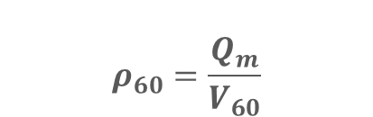
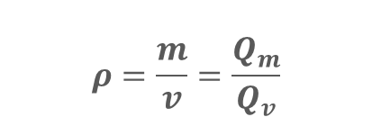
Comparing Density Values
Volumetric flow (V_{process}) can be compensated to standard conditions
V_{process} V₆₀
$$ρ=\frac{m}{v}=\frac{Q_{m}}{Q_{v}}$$
$$ρ_{process}=\frac{Q_{m}}{V_{process}}$$
$$ρ_{60}=\frac{Q_{m}}{V_{60}}$$
$$ρ_{process}≪ρ_{60}$$

Slide 22
Questions and Answers

Slide 24
Process/Procedure
In other to get a representative sample the following procedure will be followed;
Manually close the liquid outlet valve to the nominated slug catcher.
Build level in the slug catcher to 95%.
Closed in all wells producing wells to the nominated slug catcher
Allow for a settling time of 3 to 4 hour.
Take sample from the liquid leaving the slug catcher.
Gradually drain the vessel to 80%
Drain further to 60% and sample
Continue step 7 to 40%, 20%, 10% and 5%
Analyse condensate and use properties to compute density, Coriolis correction factor and Algorithm.

Slide 25
Gas well Testing cont’d
The wells are allowed to flow at their maximum potentials for a pre-determined time for stability.
The total condensate flow from the slug catcher is then measured and recorded.
Flow is reduced from in steps of 20MMSCFD (Highest to lowest) from the well to be tested while other wells on the node are kept at maximum flowrates.
The total condensate from the slug catcher is measured and recorded at each reduced rate of the well being tested.
The drop in the total condensate is attributed to the reduced flow from the well being tested.
Condensate samples are taken at reduced flow rate of the well being tested to corroborate the reading from the Coriolis meter.

Slide 26
Gas well Testing cont’d
Testing by elimination.
In this method all other wells flowing into the slug catcher are closed in leaving only the well being tested.
The gas flowrate of the well is increased stepwise.
The condensate flowrate leaving the slug catcher is measured and recorded.
The level in the slug catcher is maintained at a particular level throughout the test duration.
The measured condensate leaving the slug catcher is taken as the condensate production of the well at the particular flowrate.
The reduction in the water load in the condensate is taken as the water cut of the well at the particular flowrate.

Slide 27
Results and Findings
@ 1700hrs, density = 1013kg/m³ (lab); 1008kg/m³ (Coriolis)
@ 1715hrs, density = 742kg/m³ (lab); 613kg/m³ (Coriolis)
Real time value.
A difference between lab and Coriolis values.

Slide 28
Results and Findings
A difference exits between laboratory analysis and real time Coriolis values.
Laboratory is corrected to standard conditions@ 1700hrs, density = 1013kg/m³ (lab); 1008kg/m³ (Coriolis)
@ 1715hrs, density = 742kg/m³ (lab); 613kg/m³ (Coriolis)
Real time value.
A difference between lab and Coriolis values. 626kg/m³
WC= 626-613/(1008-613)=

Slide 29
Agenda
Procedure
Precautions Taken
Results and Findings
Discussions.
Way forward and further action.

Slide 30
Benefits
Value of Data.
Better allocation.
Cost savings.

